Slide 1
G2M CASE STUDY
Virtual Internship Project
14th February 2024

Slide 2
XYZ is a private firm in US. Due to remarkable growth in the Cab Industry in last few years and multiple key players in the market, it is planning for an investment in Cab industry and as per their Go-to-Market(G2M) strategy they want to understand the market before taking final decision
Project delivery:
You have been provided with multiple data sets that contains information on 2 cab companies to analyse and come up with actionable insights
The analysis follows the process below
General Understanding of the data
Assessment of Profitability
Evaluation of the users
Recommendation
.

Slide 3
Users Per City
New York city has the Highest cab users of over 302,149 followed next is San Francisco with 213,609, Chicago with 168,468, and Los Angeles with 144,132

Slide 4
Population Per City
We can observe that the states with the highest population in millions do not all reflect the highest number of cab users in totality

Slide 5
Cash vs Card Payment
Cash 176,107
Card 263,991 a ratio of 3 to 2

Slide 6
Profit Margin By Cab Company for all Cities
Yellow Cab makes the most profit cumulatively over 729% more than Pink Cab

Slide 7
Company Profit per Year
2016 saw a margin increase by 19% to 2017 and fall by 18.4% to 2018 for yellow cab.
Pink Cab saw and increase in margin by 18.6% from 2016 to 2017 and a fall by 23.2%

Slide 8
Kilometers Travelled
Both companies have fared well in maintaining the Kilometers of travel per city over 2 year 11 months and counting
In 2016 , Yellow Cab: 1,859,978.21 miles against 563,509
In 2018, yellow travelled 2,124,560 as against 661,739
In 2017, Yellow Cab :2,214,879 against 685,823 Miles

Slide 9
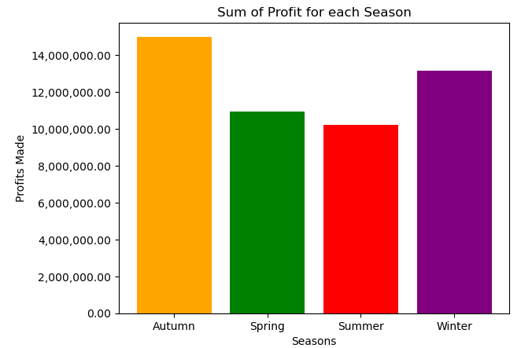
Kilometers Travelled
Analyzing margins by seasons of the year, shows that Autumn sees the highest amount of returns of over 15 million followed by winter with over 13 Million

Slide 10
Income By Age Bracket
Younger people outearn older people by a very large gap the fall in income is mostly observed at age 41

Slide 11
Kilometers Travelled
More young people than old prefer card payment over cash

Slide 12
Repeat Users by age
Aged 18 to 40 have the highest repeat cab patronage

Slide 13
Recommendations
Yellow cab makes the most profit the most of which stems from a New York city. Cumulatively it’s profit is over 729% more than Pink cab
Investments should target cities with the most users such as New York, San Francisco, Chicago and Los Angeles
There is a seasonality in profit as Autumn and Winter comes top with profitability for both companies
YXZ investors should come to terms with the importance of card payment in recent times and invest with Yello cab being the highest facilitators of Card payment.
Young people up to the age of 40 have the highest repeat cab patronages than those over the age of 40 this enables XYZ understand its strongest market coupled with the fact that the young people out earn the old people.
Hence, I highly recommend Yellow Cab based on the above points

